Slide 1

Exploratory Data Analysis - MATH485 Term Project The Anatomy of AI Perception: A Statistical Journey Through Youth’s Dance with Technology Yapay Zekâ Algısının Anatomisi: Gençliğin Teknolojiyle Dansı ile İstatistiksel Bir Yolculuk
Mehmet Arda Uçar 20210602211

Slide 2

Statistical Analysis of Young People's Perception of Artificial Intelligence
The rapid development of artificial intelligence technologies has led to various fears and insecurities in society, especially among young people. This situation has become an important research topic in terms of the future of technology and adaptation processes. By analyzing young people's perceptions of artificial intelligence, it is possible to understand the underlying causes of their fears and contribute to the development of appropriate education and awareness programs.
In our presentation, factors such as young people's attitudes toward artificial intelligence, their social media usage, and their interest in technology will be analyzed using statistical methods.

Slide 3
Justification of Selected Questions and Their Scientific Relevance
1. Technology Interest
Interest in technology is a well-known factor in predicting attitudes toward emerging technologies. Studies show that individuals with higher interest tend to report lower levels of fear toward AI, as familiarity often reduces anxiety (Nomura et al., 2008).
2. Social Media Usage (hours/day)
Social media plays a significant role in shaping perceptions through exposure to both factual and misleading content about AI. Misinformation or sensationalized AI news can amplify fear (Madden et al., 2021).
3. AI Usage Frequency (per week)
According to exposure theory, direct interaction with AI systems can reduce uncertainty and fear. Frequent users are typically less afraid, as personal experience improves familiarity and trust.
4. Gender
Gender has been linked to differing perceptions of risk and technology. Some studies indicate that women may express more caution or concern toward AI applications, which justifies analyzing this variable (Li et al., 2022).
Conclusion:
The chosen questions provide a scientifically valid foundation for understanding fear of AI among young individuals. They are aligned with theoretical frameworks in psychology, technology acceptance, and media studies.

Slide 4
Additional Questions to Better Understand AI Fear
1. Cognitive and Emotional Perceptions (Likert scale: 1–5)
“I am worried that AI decisions might evolve beyond human control.”
“I fear that AI systems may act unethically.”
“I trust artificial intelligence systems.” (Reverse-coded)
These statements help assess belief-driven fear and have empirical support in technology acceptance and trust literature (Nomura et al., 2006).
📌 2. Knowledge and Awareness Level
“I understand how artificial intelligence works.” (Likert: 1–5)
“I actively follow news and developments about AI.” (Likert: 1–5)
Higher knowledge levels are generally associated with lower fear (Müller & Bostrom, 2016).
📌 3. Experience and Information Sources
“I have had negative experiences with AI-powered applications.” (Yes/No)
“What is your primary source of information about AI?” (Social media, academic papers, news, YouTube, etc.)
Conclusion: These additional questions will help measure AI fear from psychological and cognitive perspectives, and improve the explanatory power of predictive models.

Slide 5
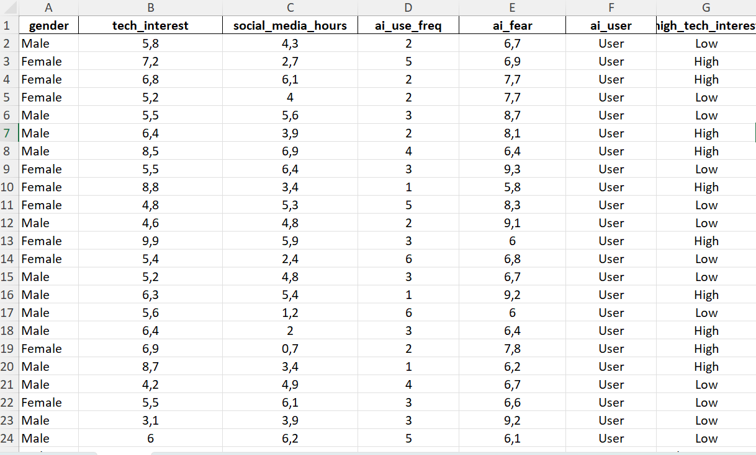

Slide 6

Problem Definition and Research Questions
Causes of Artificial Intelligence Fear
Demographic Effects
The impact of demographic factors, such as gender, on young people's perception of artificial intelligence is being investigated.
The relationships between young people's AI fears and their social media usage, interest in technology, and frequency of AI usage are being examined.
Predictive Factors
Identifying which variables best predict AI fear.

Slide 7
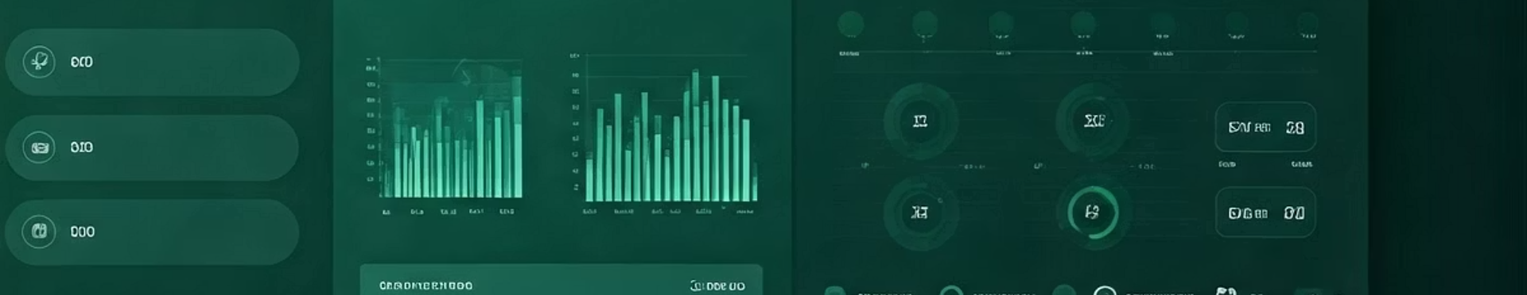
Project Purpose and Objectives
Dynamic Data Analysis
AI Fear Prediction
Statistical Tests Testler
Analyzing survey data through an interactive application based on R Shiny.
Predicting artificial intelligence fear based on user-provided data.
Applying reliable tests across different variables and interpreting the results.

Slide 8
Dataset and Its Features
Participants
Features
Simulated survey data from 150 university students was used.
Cinsiyet (Kadın/Erkek)
Yapay Zekâ Korku Seviyesi (1-10)
Teknoloji İlgisi (1-10)
Sosyal Medya Kullanım Süresi (saat/gün)
AI Kullanım Sıklığı (hafta/ke)z

Slide 9





Statistical Methods Used
t-Tests
Correlation Analysis
Chi-Square Test
Used for individual and group comparisons.
The strength of the relationship between variables was evaluated.
Independence of categorical variables was examined.
Linear Regression
Models were built to predict AI fear.

Slide 10
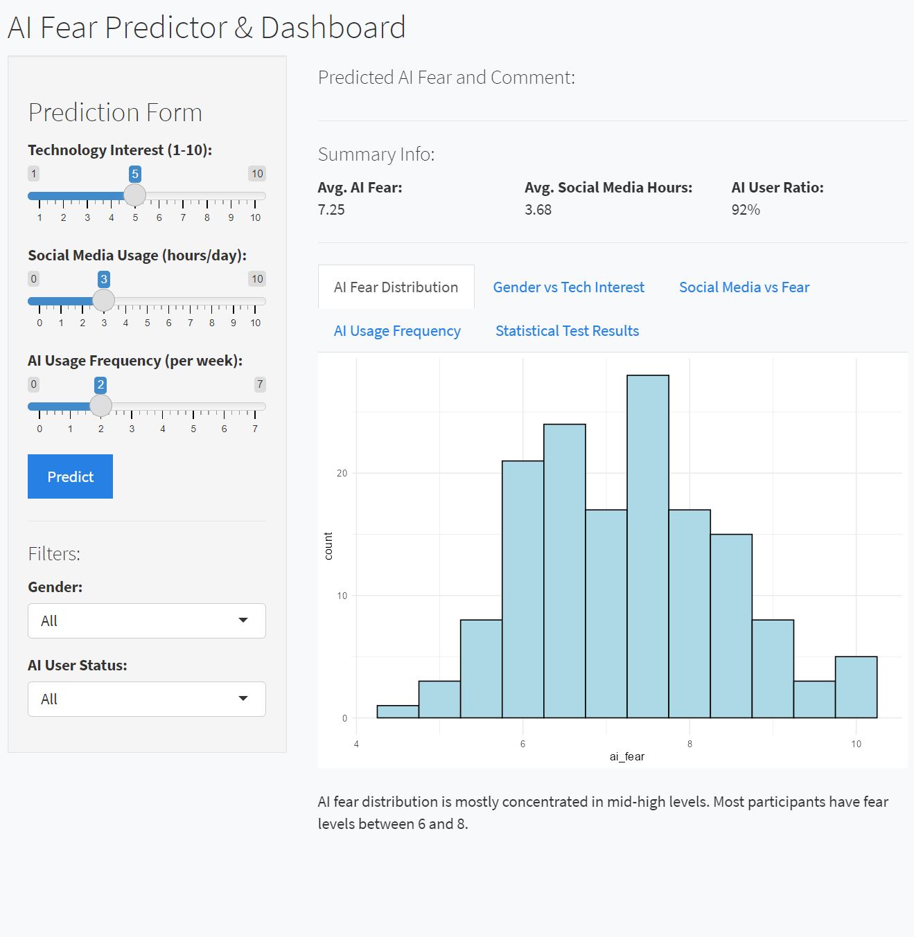
Developed R Shiny Application
User Input
Real-Time Visualization
Inputs such as interest in technology, social media usage, and AI usage frequency can be entered.
Data analysis is performed dynamically using histograms, boxplots, and scatter plots.
Statistical Results
Test results are presented and interpreted in a user-friendly format.

Slide 11
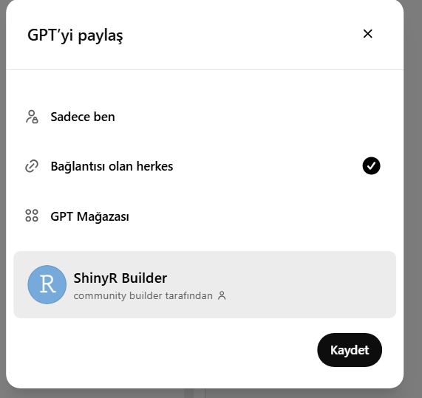
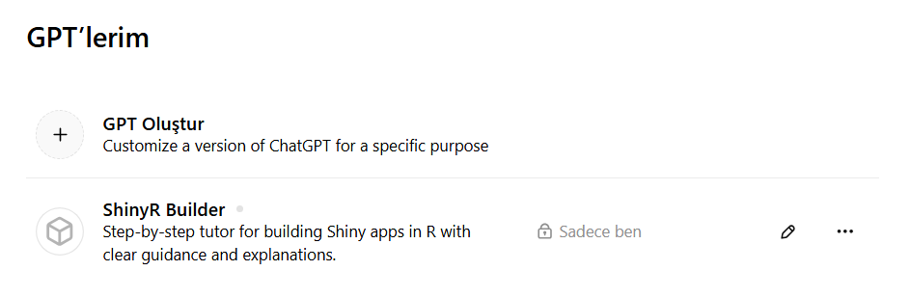
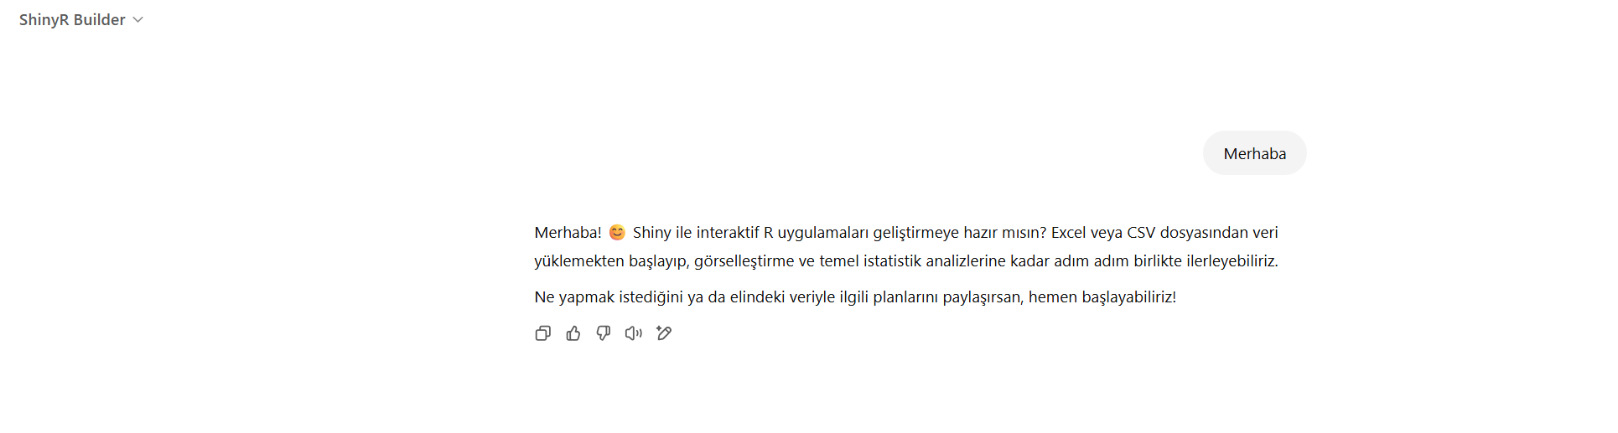

Slide 12
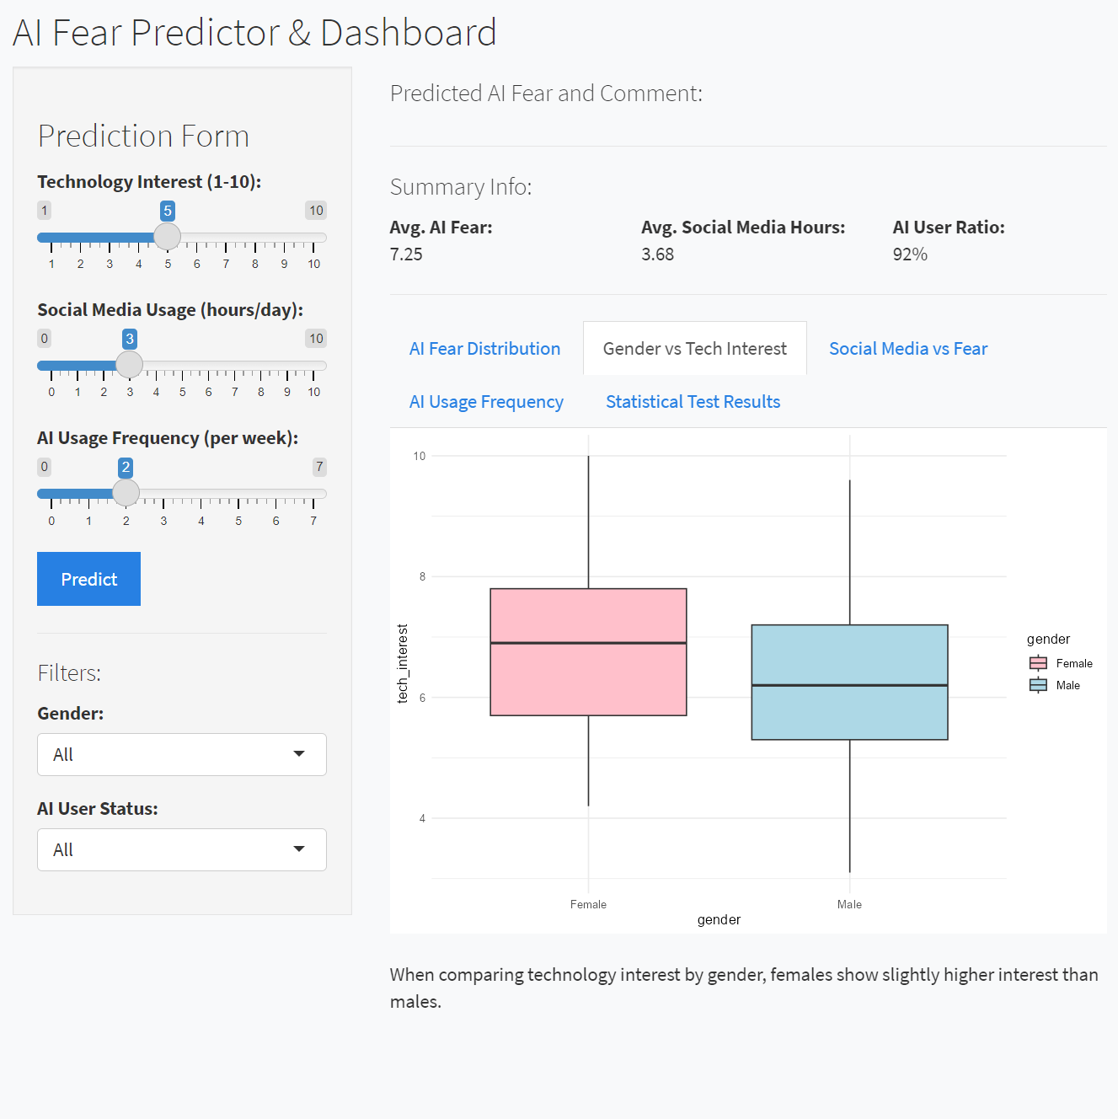
Sample Data Visualization: Histogram and Boxplot
The distribution of AI fear levels in the dataset can be observed through a histogram. Additionally, changes in AI fear based on gender can be visualized using boxplots. These charts allow for a clear understanding of differences within the distribution.

Slide 13
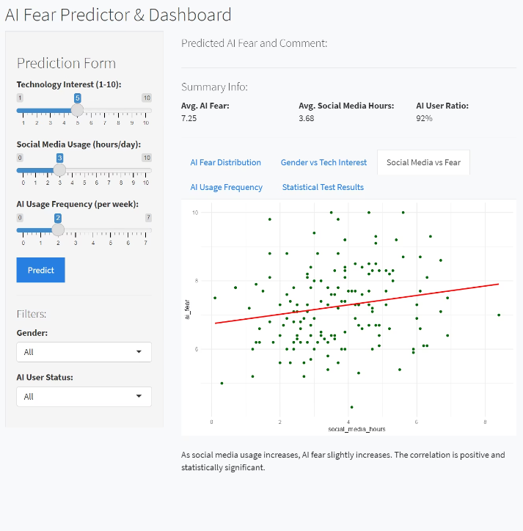
Örnek Veri Görselleştirmesi: Scatter Plot ve Bar Plot
Scatter plot, teknoloji ilgisi ile AI korkusu arasındaki ilişkiyi analiz etmek için kullanılmıştır. Bu sayede pozitif ya da negatif korelasyon olup olmadığı anlaşılır.
Bar plot ise haftalık AI kullanım sıklığının cinsiyete göre dağılımını göstererek demografik farklılıklar hakkında bilgi verir.

Slide 14
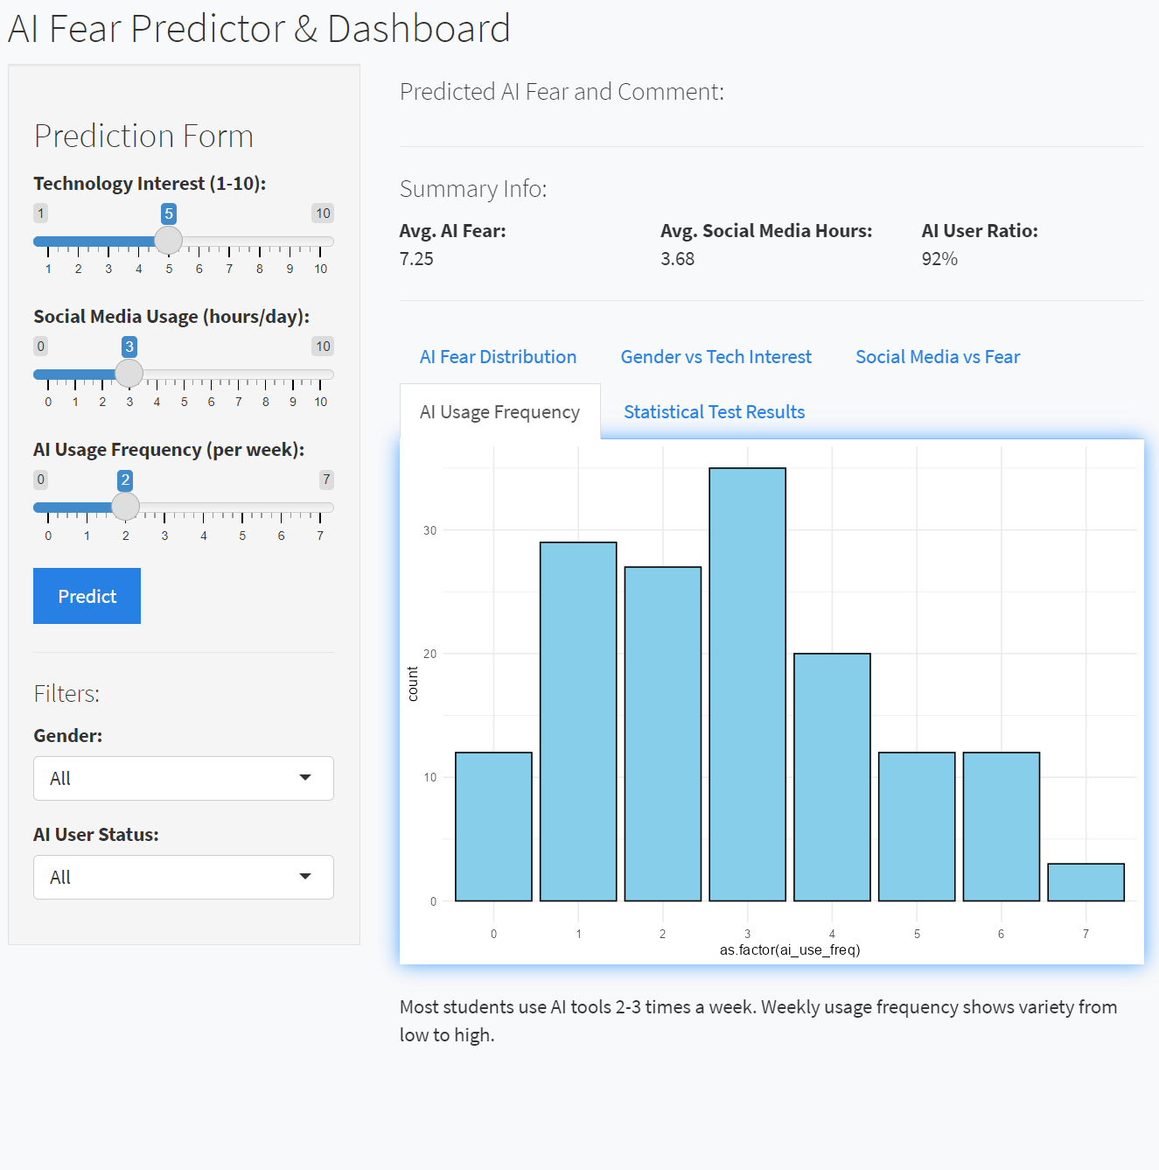
Project Results and Interpretations
A negative relationship was found between AI fear and interest in technology.
Social media usage duration does not have a significant effect on AI fear.
Gender difference emerged as an important factor in understanding AI fear.
These results suggest that increasing technological interest may help reduce young people's fears toward artificial intelligence.

Slide 15
Conclusion and Future Work
Understanding Youth Perception of AI
Role of the Application
Future Steps
The data obtained through statistical methods provided a foundation for forming healthier educational strategies.
The R Shiny application allowed real-time analysis of the effects of various variables and served as a powerful tool for educators.
It is planned to expand the datasets and develop intervention strategies aimed at reducing fear of artificial intelligence.

Slide 16
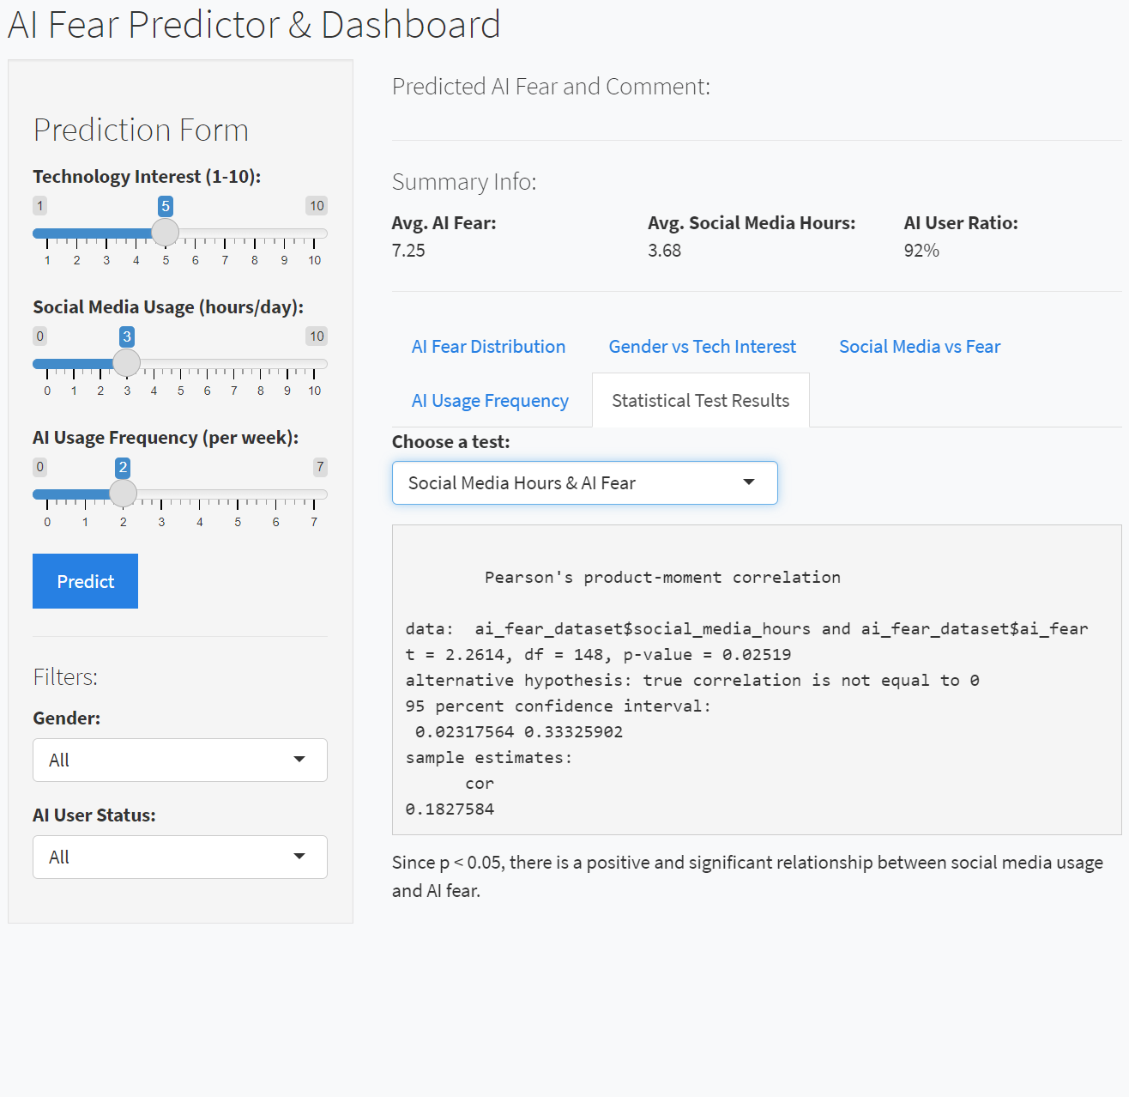
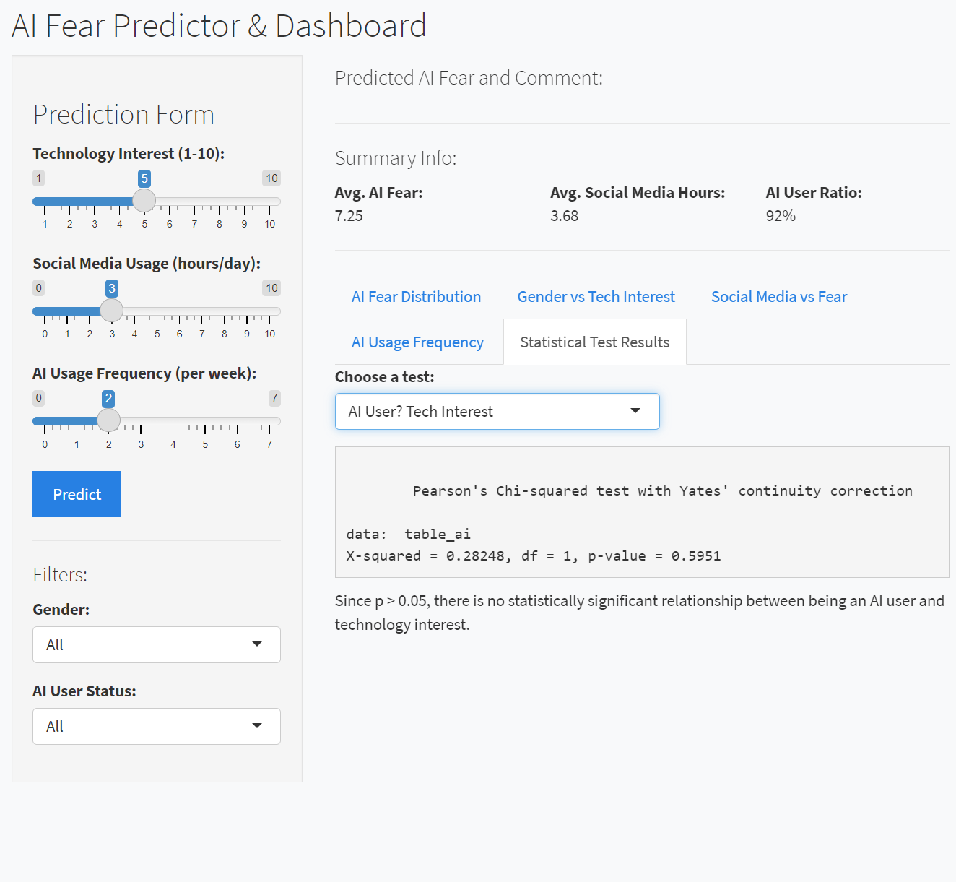

Slide 17
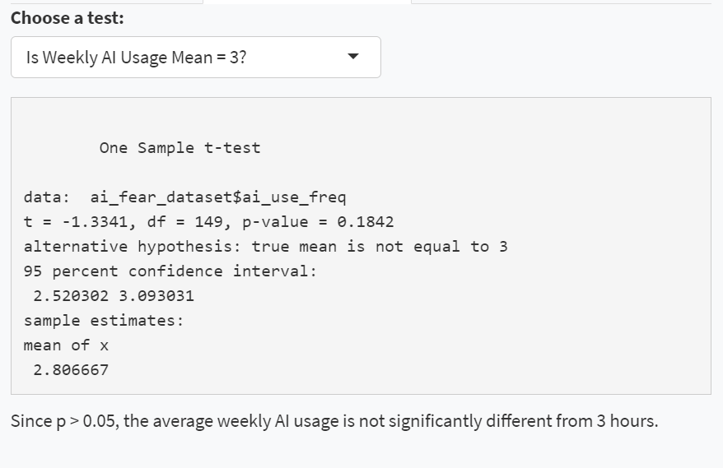
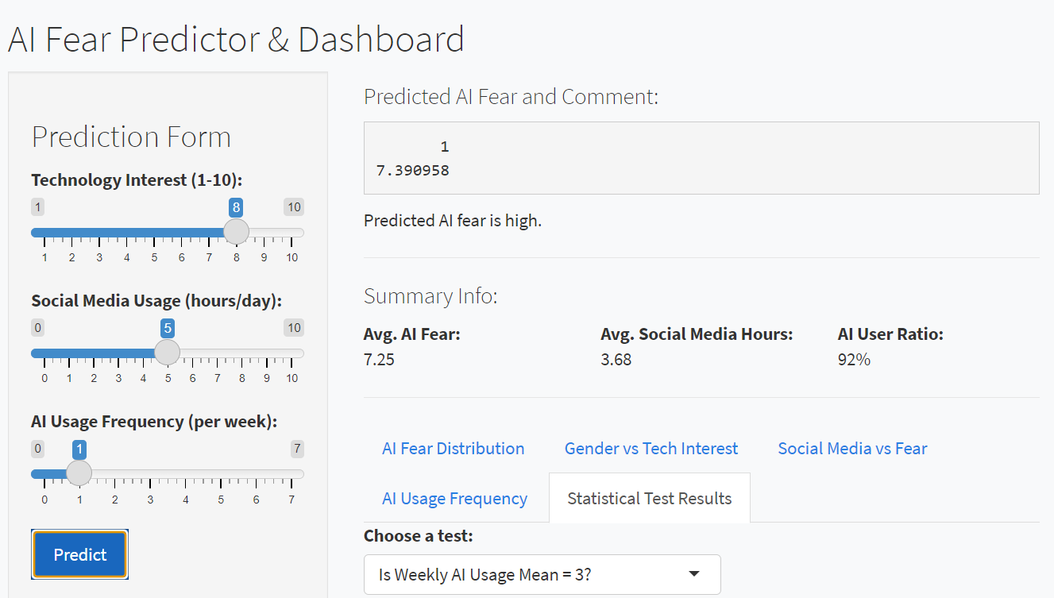
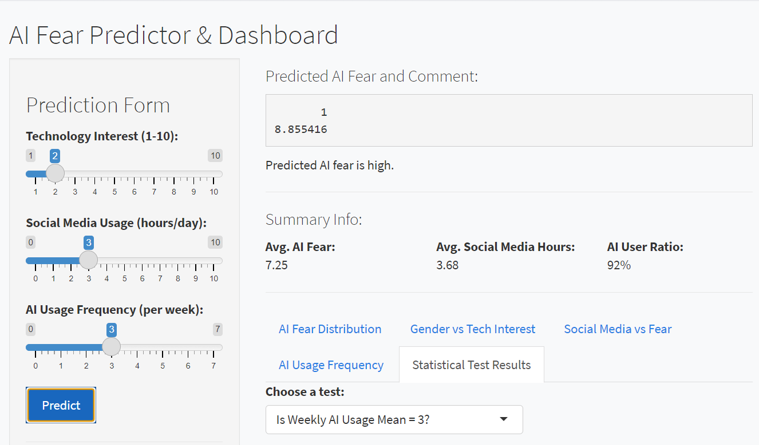

Slide 18
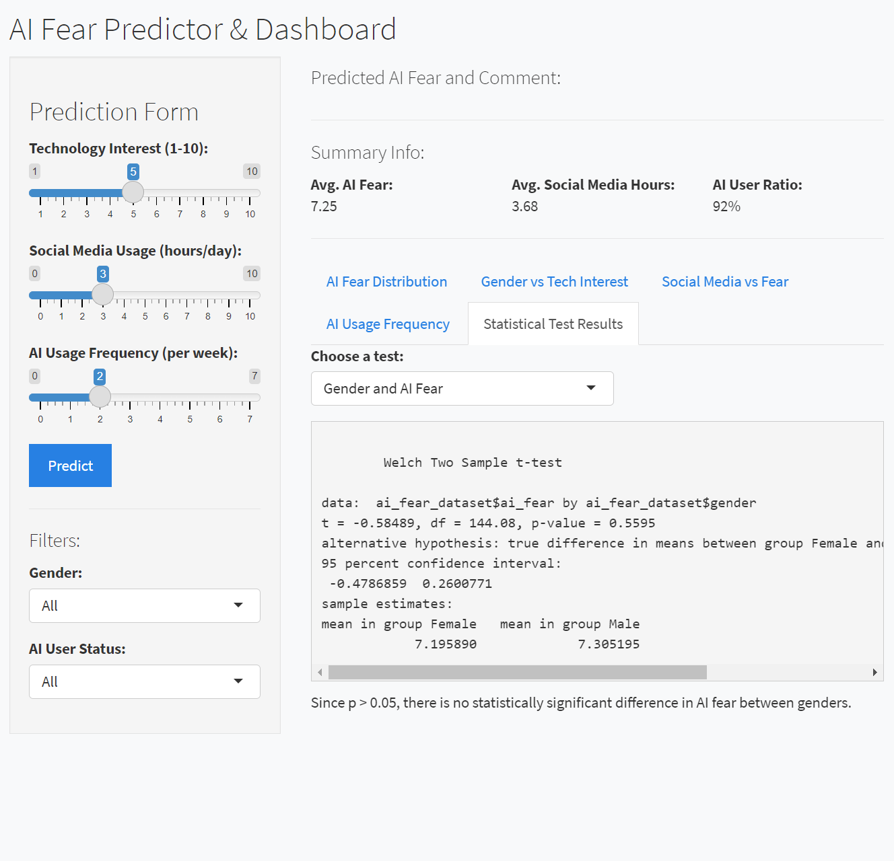
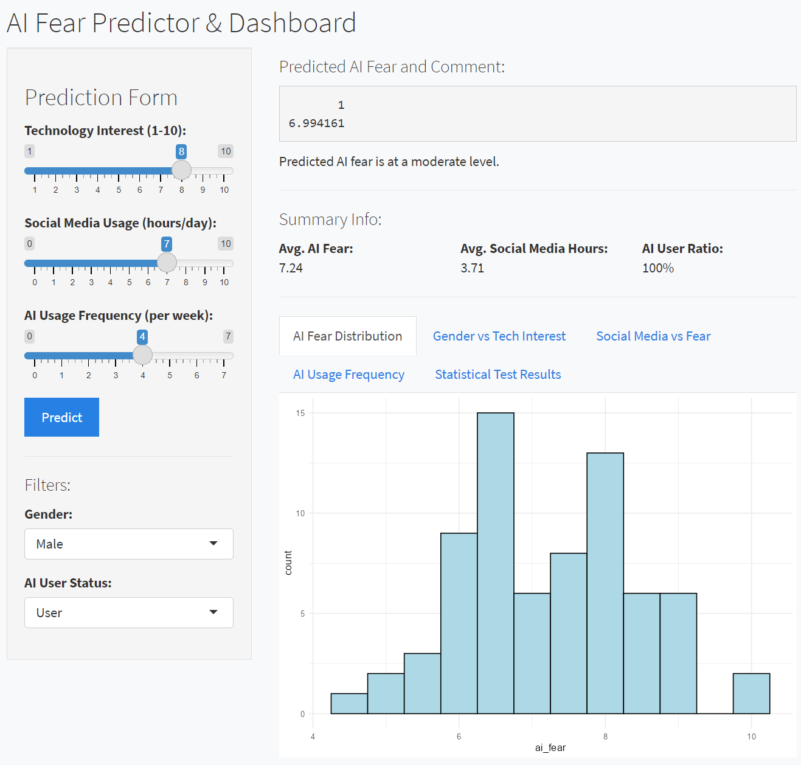

Slide 19
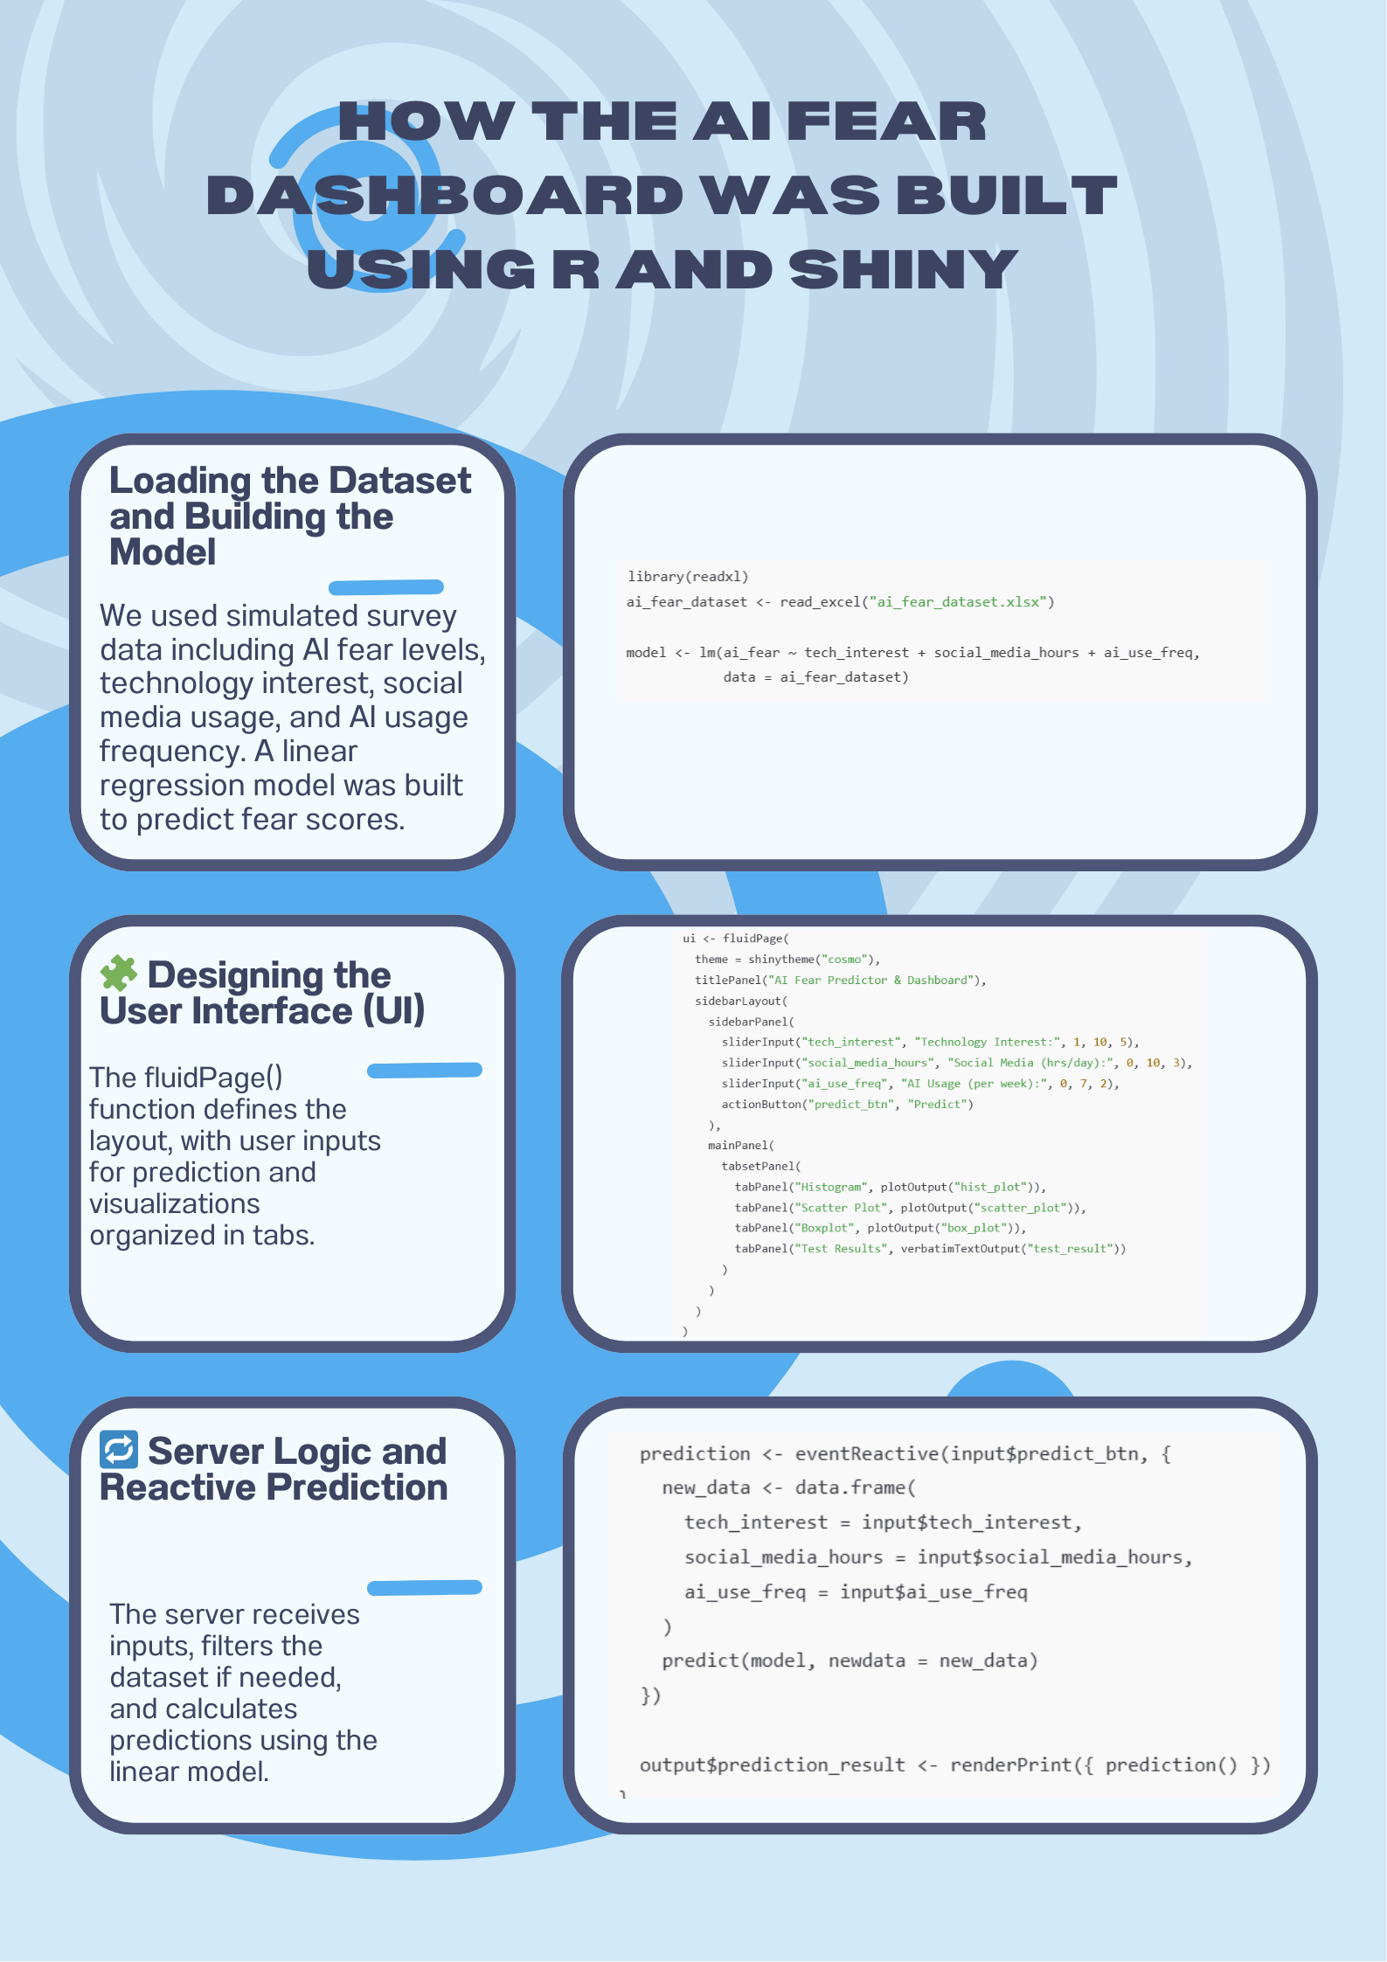

Slide 20
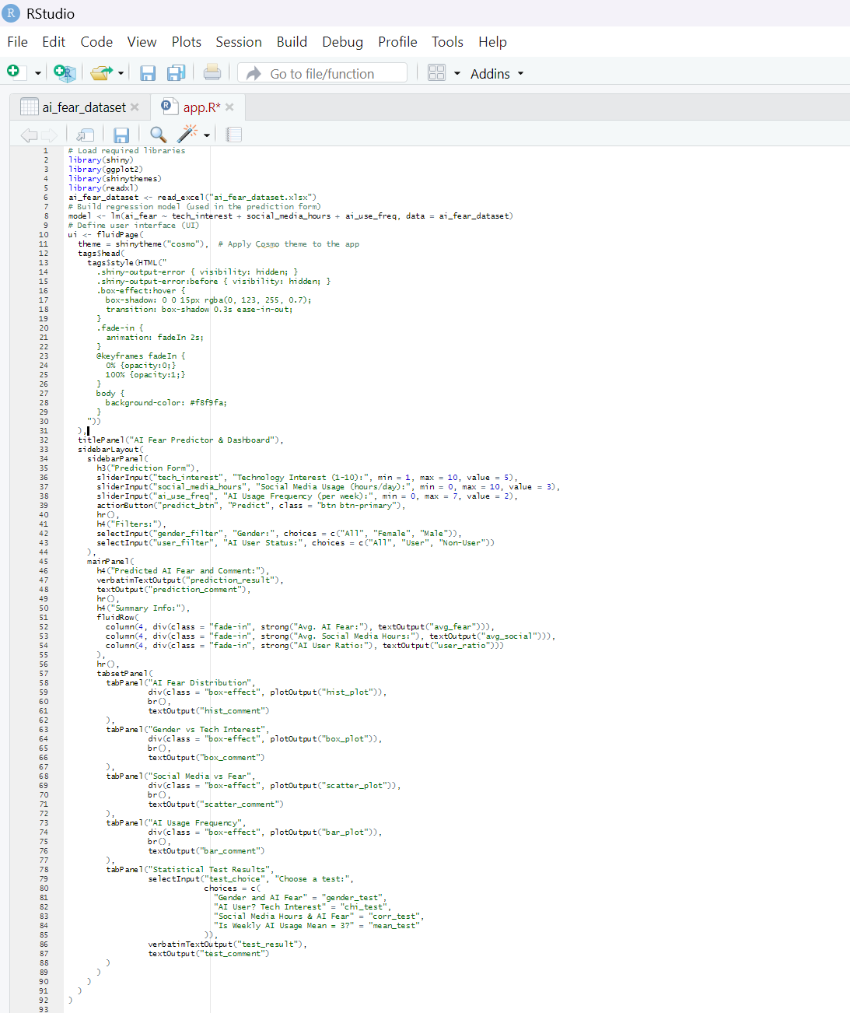

Slide 21
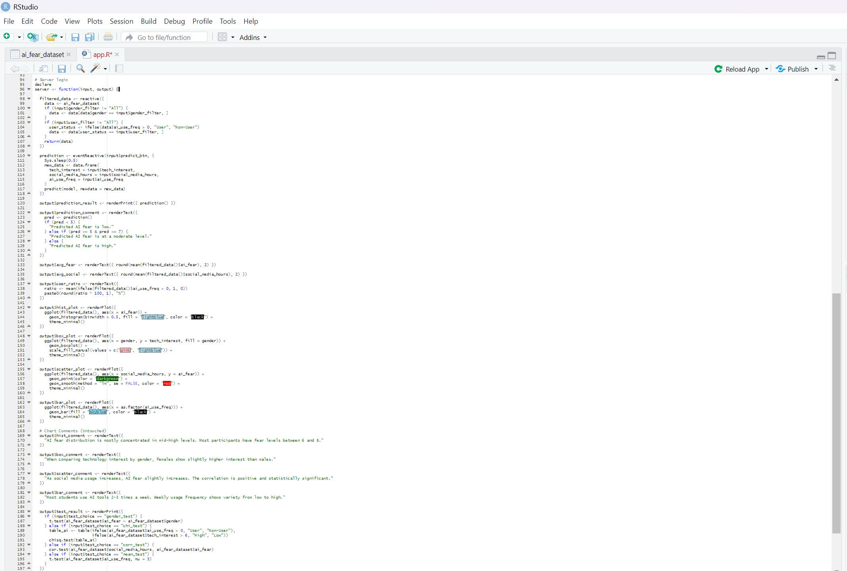

Slide 22
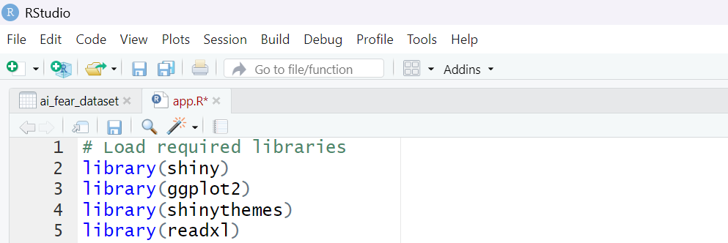
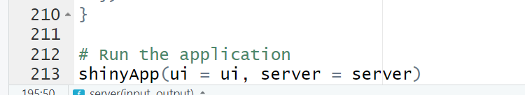

Slide 23
Thank You for Your Attention! We welcome your questions and feedback.

